Slide 1
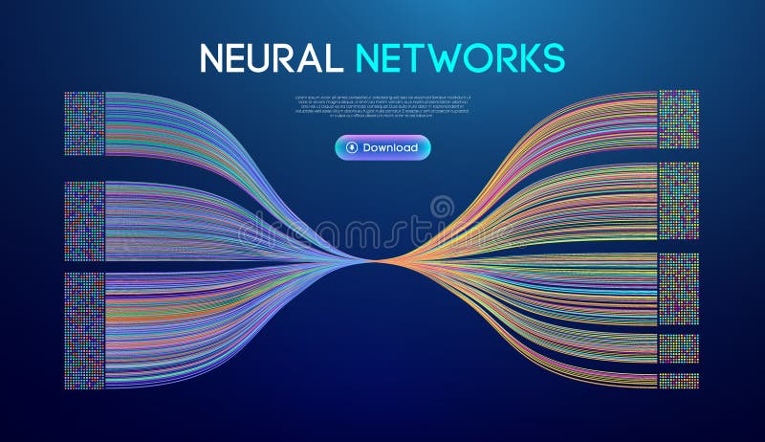
Concepts of Data Mining
Automated Data Mining and Pattern Discovery System
for Unstructured News Corpora
System Design Review
April 2026
CDM Project Documentation

Slide 2
Navigation
Table of Contents
01
System Introduction
02
Dataset Foundation
03
System Architecture
Offline-first hybrid AI architecture with explainable intelligence capabilities
AG News corpus structure with 120K articles and frozen dataset methodology
Decoupled client-server paradigm with three-tier design
04
Database Design
05
Data Preprocessing
06
Feature Extraction
DuckDB OLAP-optimized warehouse with columnar storage
Text normalization pipeline with 37.2% feature space reduction
Hybrid TF-IDF and transformer embeddings with custom weighting
07
Mining Algorithms
08
Visualization
09
Challenges & Solutions
K-Means, Apriori, and SVM implementations with performance metrics
Interactive dashboard with Chart.js and Tableau integration
Technical hurdles and engineering resolutions

Slide 3
01 / System Overview
Offline-First Hybrid AI Architecture
Core Value Proposition
Key Differentiators
A standalone, offline-first hybrid AI system designed to transform unstructured news corpora into mathematically-backed transparent intelligence. Unlike conventional cloud-dependent engines, this architecture ensures complete data sovereignty and eliminates latency concerns.
Processing Speed
< 5s
Data Privacy
100%
Data Sovereignty
Zero Latency
Explainability
XAI
Complete local processing without cloud dependency
Embedded processing eliminates network delays
Operational Flow
Engineering Baseline
Raw Ingestion
1
Embedded DuckDB Instance
Serverless OLAP database (news_corpus.duckdb) enabling high-speed local processing of heterogeneous text
Preprocessing
2
Small Language Models Integration
Pattern Mining
Ollama and LM Studio for Explainable AI (XAI) — acting strictly as analytical interpreters without hallucination
Visualization

Slide 4
02 / Data Foundation
AG News Corpus Structure
Dataset Overview
Schema Structure
The empirical foundation utilizes the robust AG News Dataset sourced via Hugging Face repository, representing a diverse aggregate of journalistic sources, topic categories, and publication timelines.
title
VARCHAR
Headline serving as concentrated summary
120K
4
content
TEXT
Primary unstructured body with narrative
Total Articles
Categories
published_at
TIMESTAMP
30K
7
Temporal timestamp for time-series mining
Per Category
Years (2018-24)
source
VARCHAR
Publisher entity (Reuters, AP, etc.)
Frozen Corpus Methodology
category
VARCHAR
The dataset has been completely isolated and frozen in a dedicated analytical warehouse. This ensures all downstream clustering, classification, and association rule mining algorithms produce deterministic, repeatable, and academically verifiable results without structural drift.
Thematic classification label
Category Distribution
World · Sports
Perfectly Balanced
Business · Tech

Slide 5
03 / Architecture
High-Level System Architecture
The architecture follows a decoupled client-server paradigm designed for scalability, maintainability, and clear separation of concerns. This three-tier structure enables independent development and deployment of each component.
Client Layer
Server Layer
Data Engine
HTML/Vanilla JS with Chart.js
Flask REST API
DuckDB + ML Stack
Interactive Dashboard
mining_engine.py
DuckDB OLAP Store
Real-time Visualization
analytics_engine.py
pandas Integration
User Controls
RESTful Endpoints
scikit-learn Models
End-to-End Data Flow
Architecture Benefits
Separation of Concerns
Independent component scaling
API-Driven Design
Ingestion
Preprocess
Mine
Visualize
Easy integration & testing
CSV/API
Clean/Tokenize
K-Means/Apriori
Dashboard
Horizontal Scalability
Add workers as needed

Slide 6

04 / Data Layer
Database & Warehouse Design
DuckDB
Primary Schema: news_articles
OLAP-Optimized Engine
id
VARCHAR
DuckDB serves as the embedded transactional data store, specifically optimized for analytical workloads. Its columnar storage format dramatically improves query performance by reading only required columns.
Primary Key
title
VARCHAR
Article headline
Storage Format
Query Execution
Columnar
Vectorized
content
TEXT
Full article text
Processing
Deployment
source
In-Memory
Serverless
Publisher entity
VARCHAR
category
VARCHAR
DuckDB vs SQLite
Thematic label
Analytical Query Speed
10-100x faster
published_at
TIMESTAMP
Timestamp
Aggregation Performance
Superior
Memory Efficiency
Optimized
url
VARCHAR
Source link
Data Ingestion Methods
Bulk Import
Incremental
CSV streams for batch loading
Live API updates

Slide 7
05 / Pipeline
Data Preprocessing Pipeline
A rigorous custom preprocessing pipeline transforms raw news articles into normalized tokens suitable for feature extraction. This sequential workflow reduces dimensionality while isolating core semantic value, achieving 37.2% feature space reduction.
1
2
3
4
5
Normalization
Tokenization
Stopword Removal
Lemmatization
N-gram Extraction
Lowercase, remove punctuation & special chars
Split into meaningful units
Filter 571 standard + domain terms
WordNet morphy processor
Capture phrase patterns
["wall", "st", "bears"]
"bears" → "bear"
["wall_st", "st_bear"]
"Wall St. Bears" → "wall st bears"
Remove: "the", "and", "in"
Raw Document Example
Cleaned Document
"Wall St. Bears Claw Back Into the Black (Reuters) Reuters - Short-sellers, Wall Street's dwindling band of ultra-cynics, are seeing green again..."
["wall", "street", "bear", "claw", "back", "black", "reuters", "short", "seller", "street", "dwindle", "band", "ultra", "cynic", "see", "green"]
Issues:
Punctuation
Mixed case
Stopwords
Result:
Dense tokens
Semantic focus
Reduced noise

Slide 8
06 / Feature Engineering
Feature Extraction & Selection Strategy
Hybrid Vectorization Approach
Feature Matrix
The system employs a hybrid approach combining TF-IDF vectorization with Sentence Transformers for dense embeddings, capturing both topical keywords and deep semantic context.
Max Features
5,000
N-gram Range
(1, 2)
TF-IDF
Transformers
Matrix Format
CSR Sparse
Term Frequency-Inverse Document Frequency
Dense Sentence Embeddings
Weighted keyword frequencies
Semantic context capture
Feature Examples
Sparse matrix output
Dense vector representation
Interpretable features
Deep learning based
Unigrams (1-word)
trump
election
government
market
Custom Mathematical Weighting
Bigrams (2-word)
stock_market
white_house
economic_reform
Recency Multiplier
1.2x
Source Authority
0.91
Temporal decay function amplifying newer articles
Weight adjustment based on publisher reliability
Classification Accuracy
98.5%

Slide 9
07 / Algorithms
Core Mining Algorithms: K-Means Clustering
Algorithm Overview
K-Means Process Flow
K-Means clustering is employed for unsupervised topic discovery, grouping similar news articles into coherent clusters based on their TF-IDF vector representations. The algorithm minimizes intra-cluster variance through iterative centroid updates.
1
Initialize Centroids
Randomly select K initial cluster centers
2
Assign Points
Objective Function
Calculate distance, assign to nearest centroid
J = Σᵢ₌₁ᵏ Σⱼ₌₁ⁿ D(xⱼ, zᵢ)²
3
Update Centroids
Minimize distance between points and cluster centroids
Recalculate center as mean of assigned points
Algorithm Type
Clustering Method
4
Convergence Check
Unsupervised
Partition-based
Repeat until centroids stabilize
Implementation Parameters
Performance Metrics
1
Dynamic max_features
TF-IDF dimensionality constraints to limit feature space
Memory Optimization
Dynamic Bounds
2
Frozen Corpus Pattern
Reproducibility
Frozen Corpus
Ensures reproducible, deterministic cluster assignments
3
2D PCA Visualization
Visualization
2D PCA
Dimensionality reduction for scatter plot representation

Slide 10
07 / Algorithms
Core Mining Algorithms: Apriori Association Rules
Algorithm Overview
Rule Metrics
The Apriori algorithm discovers latent relationships between entities in news text (e.g., "Economic Reform" → "Policy Shifts"). It employs a level-wise search approach to identify frequent itemsets and generate association rules.
Support
P(A ∪ B) — Frequency of itemset
Apriori Property
Confidence
If an itemset is frequent, all its subsets must also be frequent. Conversely, if an itemset is infrequent, all its supersets are infrequent. This property enables efficient pruning.
P(B|A) = P(A ∪ B) / P(A)
Lift
P(B|A) / P(B) — Strength of association
Level-Wise Search Process
1
Join Step
2
Prune Step
Example Association Rules
Lₖ₋₁ × Lₖ₋₁ → Cₖ (generate candidates)
Remove candidates with infrequent subsets
{economic} → {reform}
conf: 0.78
lift: 2.3
3
Count Support
4
Generate Lₖ
Scan database, count candidate frequency
Keep candidates meeting min_support
{stock, market} → {trade}
conf: 0.82
lift: 1.9
{policy} → {government}
conf: 0.71
lift: 1.7
Dashboard Display
Apriori Rules Table

Slide 11
07 / Algorithms
Core Mining Algorithms: SVM Classification
Algorithm Overview
Performance by Vectorization
Support Vector Machine (SVM) is employed for supervised multi-class classification, categorizing news articles into predefined thematic classes. The algorithm finds an optimal hyperplane that maximizes the margin between different classes.
Bag of Words
99.81%
F1-Score: 0.9980
TF-IDF
99.52%
Linear Kernel Configuration
F1-Score: 0.9949
The linear kernel is selected for its computational efficiency and strong performance on high-dimensional text data. It finds the hyperplane w·x + b = 0 that best separates classes.
Word2Vec
96.54%
F1-Score: 0.9644
Algorithm Type
Classification
Supervised
Multi-class
Test Configuration
SVM Mechanism
Sample Size
10,000
Hyperplane Separation
Expected Accuracy
> 85%
Finds optimal decision boundary in high-dimensional space
Margin Maximization
Evaluation Metric
F1 Score
Maximizes distance between hyperplane and nearest points
Support Vectors
Kernel Type
Linear
Critical data points defining the decision boundary
Best Configuration
SVM + BoW

Slide 12
08 / Interface
Visualization & Dashboard Framework
Dashboard Architecture
Dashboard Modules
A comprehensive, interactive analytics dashboard democratizes access to insights generated by the underlying data mining engine. Built with Chart.js and integrated with Tableau for exploratory analysis.
Top Keywords
Word clouds & frequency charts
Bar Charts
Scatter Plots
Category Spread
Category Distribution & Keyword Frequency
2D PCA K-Means Cluster Visualization
Pie charts showing distribution
Line Graphs
Data Tables
Trend Analysis
Temporal Trending Volume Over Time
Apriori Rules (Confidence, Support, Lift)
Article volume over time
Source Analytics
UI Components
Publisher volume comparison
Global Search Bar
Date Range Filters
Live Demos
Full-text corpus search
Temporal data selection
KMeans & Naive Bayes triggers
Parameter Sliders
CSV Upload Forms
Tableau Integration
K-clusters configuration
Custom dataset ingestion
Exploratory visualizations created using Tableau against the 120,000-row frozen dataset provide insights into category distributions, publication trends, and source activity.
Rendering Target
< 2s
for 5 charts

Slide 13
09 / Engineering
Technical Challenges & Solutions
1
Massive Memory Overhead
Issue: Running K-Means and Apriori on the entire 120,000-record dataset caused massive RAM consumption and timeouts.
Resolution:
• Implemented dynamic max_features constraints in TF-IDF for CDM pipeline
• Established "frozen_corpus" pattern for reproducible, fast review metrics
• Limited dimensionality to prevent memory exhaustion
2
Index Rebuild Loops
3
Module Import Failures
Issue: Backend rebuilt entire index for 120k articles on restart, causing 1-hour startup delays.
Issue: Python's strict module pathing broke when separating backend APIs from analytics scripts.
Resolution:
Resolution:
• Developed update_index incremental methodology
• Built absolute path resolution configuration
• Compare DuckDB rowid counts to index_meta.json
• Used os.path.abspath(__file__)
• Encode only new articles, append to FAISS
• Enable terminal execution from any directory
Performance Improvement
Path Resolution
1h → <5s
Cross-Directory

Slide 14
10 / Quality Assurance
Testing Framework & Performance Metrics
Test Data
Project Schedule
frozen_corpus.csv
Primary
P1
Project Approval
Requirements gathering
~120,000 records from AG News dataset
Dataset Acquisition
Deterministic
Reproducible
P2
Schema design & analysis
P3
System Architecture
Synthetic Edge Cases
Validation
Pipeline design
Null fields, malformed dates, special characters
P4
Algorithm Implementation
Robustness
Error Handling
ML model training
P5
Testing & Deployment
GUI & system tuning
Test Cases
Key Deliverables
TC1
Index Rebuild Performance
Rebuilding with updated corpus
Approved Project Proposal
Expected
< 15 seconds
Processed Dataset + Features
TC2
SVM Accuracy Validation
Architecture Documentation
10k sample classification
Expected
> 85% + F1 Score
Trained ML Models
Fully Functional System
TC3
Dashboard Rendering
Chart.js visualization load
Expected
5 charts < 2s

Slide 15
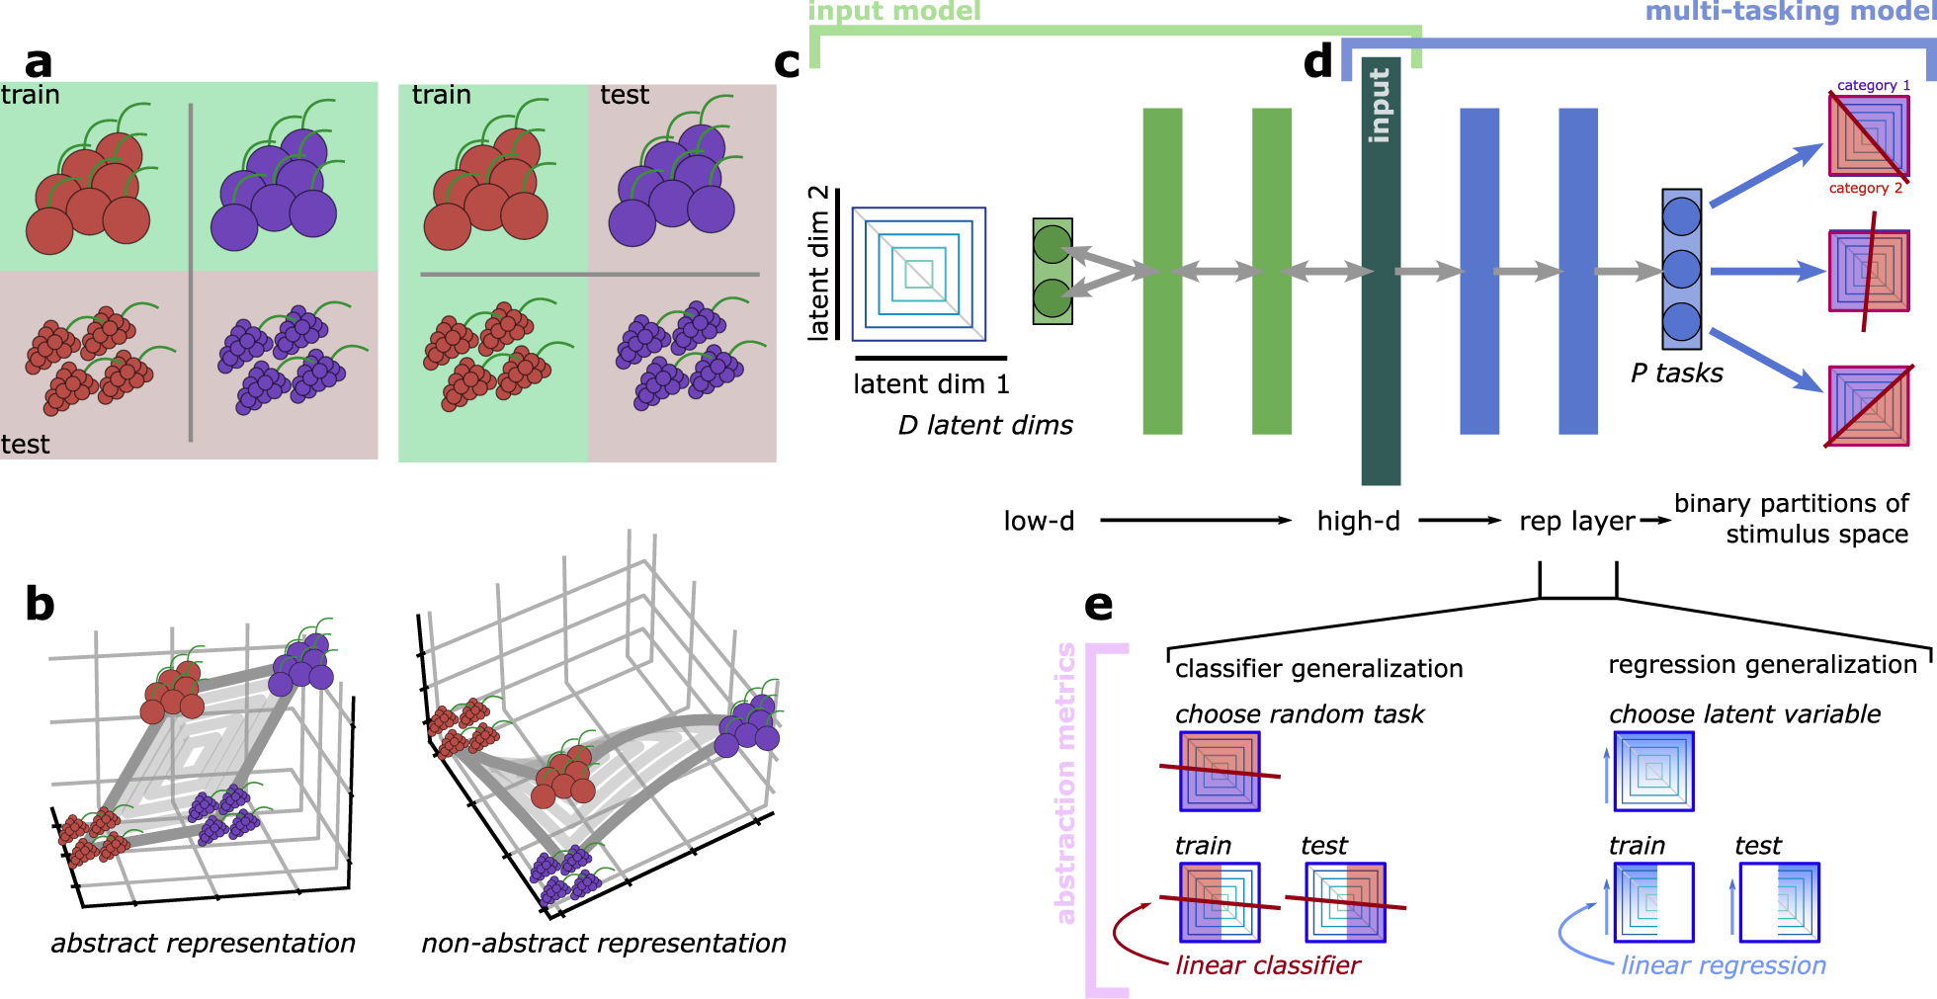
Conclusion
System Capabilities & Future Directions
The system successfully delivers a standalone, explainable AI platform for news corpus analysis with deterministic, reproducible results. By combining offline-first architecture with rigorous data mining methodologies, it transforms unstructured text into actionable intelligence.
120K
<5s
99%+
Real-time
Article Processing
Incremental Indexing
Classification Accuracy
Interactive Dashboard
Future Enhancements
Deep Learning
Multi-language
Streaming Analytics
Hybrid neural network integration
Cross-lingual corpus support
Real-time news processing
Concepts of Data Mining — System Design Review

